Slide 1
Robotic Arm Pick-and-Place in ROS 2
2026/01/10
Reporter: Zhang Xiang
Chen Yuheng

Slide 2

Project Goal
Control a Panda robotic arm
Pick and place a cylinder
The goal is to control a Panda robotic arm to pick and place a cylinder in simulation.
The specific task is to pick a cylinder from one location and place it at another in a simulated environment.

Slide 3

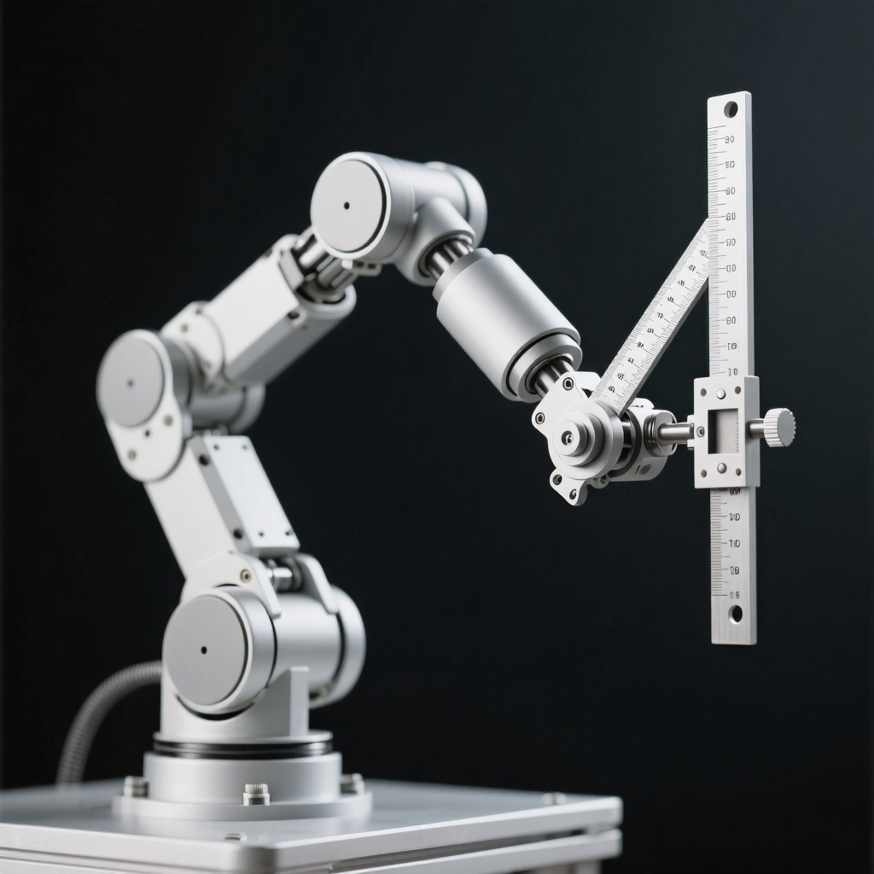
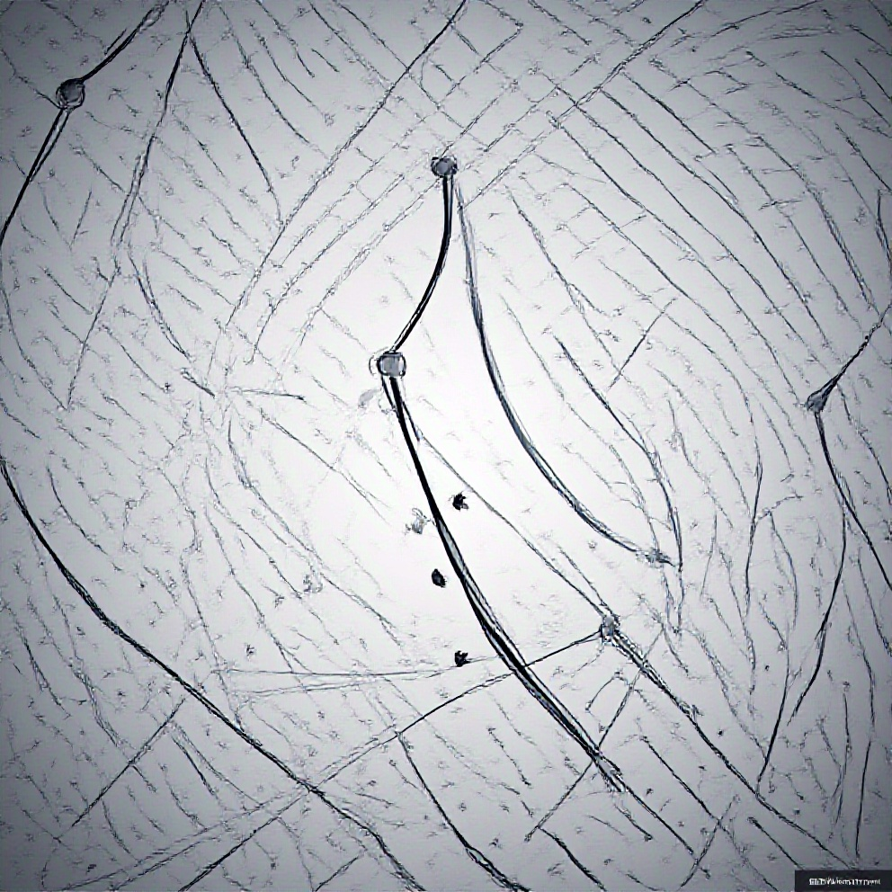
Key Challenges
Motion planning & collision avoidance
The project faces challenges in motion planning and collision avoidance to ensure smooth execution of tasks.
Inverse kinematics (IK)
Solving the inverse kinematics problem is crucial for accurate positioning and movement of the robotic arm.
Multi-stage task coordination
Coordinating multiple stages of the task, such as picking, moving, and placing, presents a significant challenge.

Slide 4




Tech Stack Used
ROS 2 Humble
The project utilizes ROS 2 Humble, the latest version of the Robot Operating System, for robotic control and communication.
MoveIt 2 (MoveIt Task Constructor)
MoveIt 2, particularly its Task Constructor, is used for motion planning and task coordination.
C++ and Python
Core logic is developed in C++ for efficiency, while Python is used for launching and scripting tasks.
RViz 2 / Gazebo
RViz 2 and Gazebo are used for visualization and simulation, allowing for testing and debugging in a virtual environment.

Slide 5
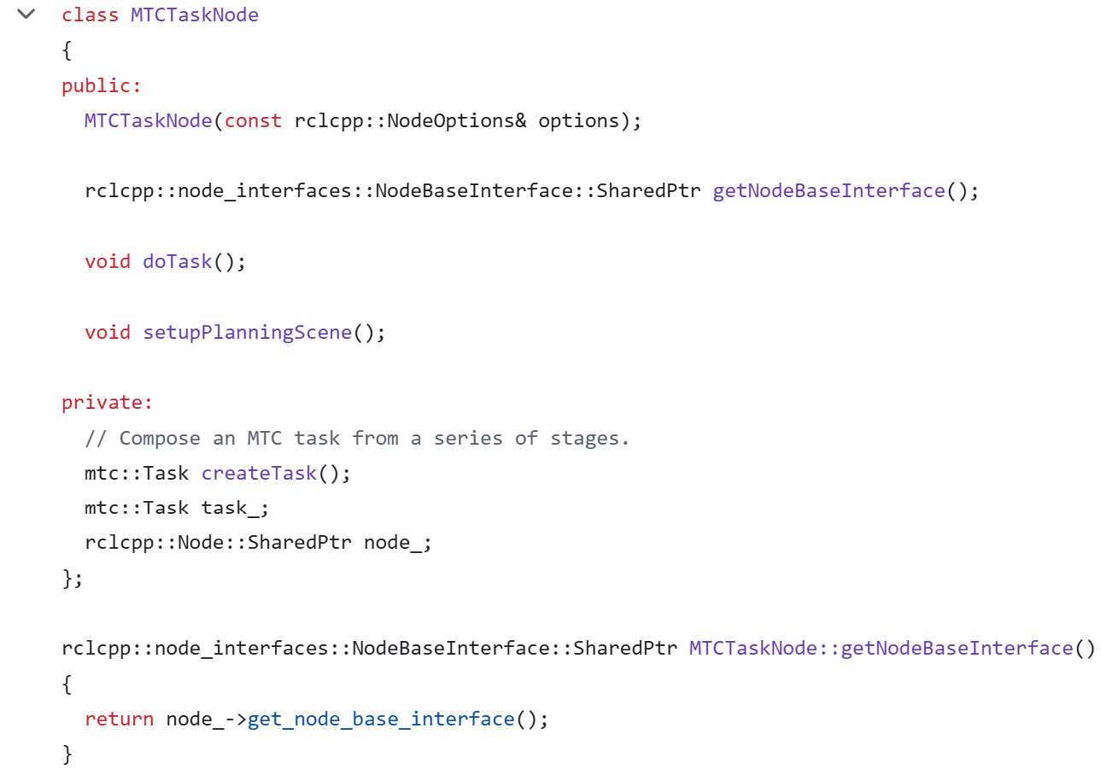
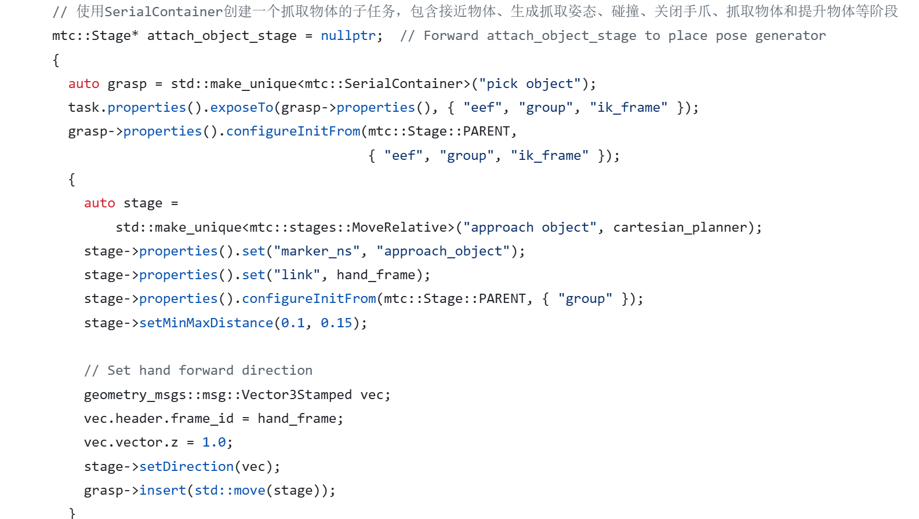
Implementation Highlights
MoveIt Task Constructor (SerialContainer)
Utilizing SerialContainer for task sequencing and execution in MoveIt 2.
Sampling planner for long-distance motion
Employing a sampling-based planner for efficient long-range movements of the robotic arm.
Cartesian planner for precise grasping
Using a Cartesian planner to ensure accurate and precise grasping of the object.
ComputeIK for grasp pose generation
Implementing ComputeIK to generate the necessary inverse kinematics for the grasping pose.

Slide 6
Reasons for Using MTC
Multi-stage task coordination
MTC enables complex, multi-stage task coordination for the robotic arm's pick-and-place operations.
Simplified FSM-based task sequencing
MTC simplifies the implementation of Finite State Machines, making task sequencing more intuitive and manageable.
Efficient motion planning
MTC's integration with MoveIt 2 provides efficient motion planning capabilities, crucial for collision-free operations.
Enhanced control over robotic arm actions
MTC allows for enhanced control and customization of the robotic arm's actions, ensuring smooth and repeatable motion.

Slide 7
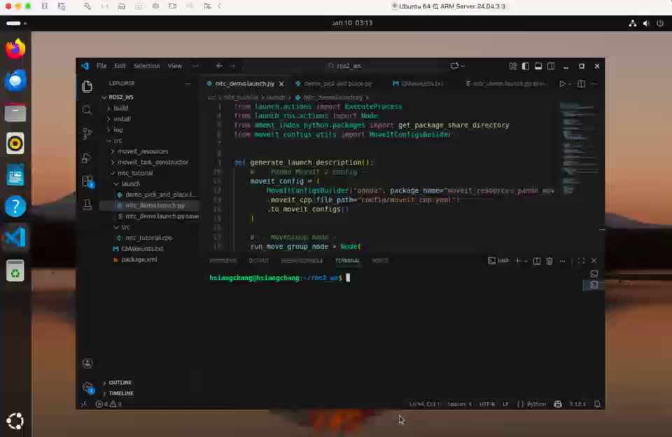
Achievements
Complete ROS 2 pipeline
We implemented a fully functional ROS 2 pick-and-place pipeline.
FSM-based task sequencing
The system utilized a Finite State Machine for efficient task sequencing.
Hands-on experience with MTC
Gained practical experience with MoveIt 2's Task Constructor.

Slide 8
Thank You
THE END

